Slide 1


KBB CAPSTONE PRESENTATION
Namrata Sharma, Grace Ye
Dante Bellins and Daniel palumbo
Georgetown Data Science Cohort 13
12/15/2018

Slide 2

ROADMAP
Motivation and target
Data source overview
Data cleaning and wrangling
Exploration data analysis
Feature engineering
Modeling
Data product
Conclusion

Slide 3

MOTIVATION AND TARGET
Motivation
Predict car listing price – Help Customers Find the Best Price for their Specific Used Car Needs
Find One or A Set of Model Forms that would be Conducive to Predicting Car Prices
Find Out If Regions and Other Demographic Data Made a Material Difference in Car Listing Price
Suggested Target
Price Prediction App
Actual Target – Jupyter Widget to show Integral components of the Solution
Demonstrate underlying abilities of possible app

Slide 4
ARCHITECTURE DATA SCIENCE WORKFLOW
Pre-Trimmed Dataset from Market Check API
Data ingestion methods varied
Data Wrangling
Analyses and Modeling
Visualizations
Given to us upon request
Original Worm Storage – AWS S3
Current Worm Storage SQLITE
ease of use with pandas and Scikit-learn was the Important Factor
Pandas
SQLITE 3
Scikit-learn
Linear Regression
Random Forest Regressor
Gradient Boost Regressor
LASSO
Ridge
Elastic Net
Knearest Regressor
Pipeline
Cross Validate
Seaborn
Matplotlib
YellowBrick
Plotly
Jupyter Widgets

Slide 5

DATA SOURCES
Marketcheck API provides access to New, Used and Certified cars inventory for all car dealers in USA and Canada
Inventories include new, used & certified listings gathered from over 52k dealerships across the US and Canada
On an average There are about 6.2M searchable listings (about 2.2M unique VINs) for Used & Certified cars from all over USA. Data includes car features like make, model, trim, color, mileage, Year and so on
The active inventory set available on target websites is refreshed once every 24 hours. All websites are tracked for changes to the inventory and only those listings that have changes published are crawled afresh

Slide 6




DATA SOURCES
Regions
Loose Boundaries:
Based on Weather and Geographic Location
Products are released the prior year so to reflect this shift we created an Age Column. Ie. 2017 = 2 (age)
Age
Zip Codes and
County List
Kept the data to 48 contiguous states and eliminated decommissioned zip codes.
Demographics
Per Capita income
Median Household income
Median Family income
Population
Number of households

Slide 7
DATA WRANGLING AND DATA STORAGE
Ingestion of CSVs and Data Wrangling through Pandas
Initial File:
~3 Million instances
Joins: Zip Code, Regions, Age, National Household Income
Eliminate Duplicate Columns
Rename Where Appropriate
Removed Makes with under 15k entries
Removed price outliers, those under $5k and over $50k
Final data file – 1.3 Million instances
Sqlite Db – Worm Storage
Most of the Wrangling was handled through Pandas dataframes
Found that we had the most Familiarity with this Package

Slide 8




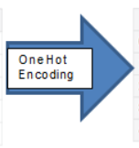
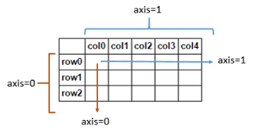
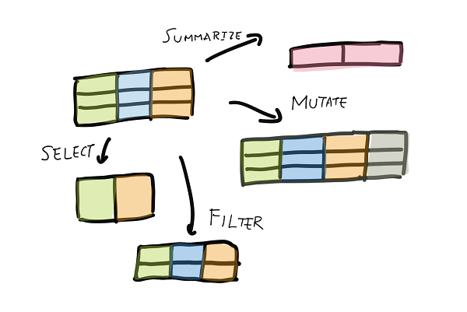
DATA WRANGLING CHALLENGES
Huge file, ~28 GB. First challenge was to figure out which field(s) were creating unnecessary bloat
Nulls in the data
Certified column needed one value imputed
Zip codes were not always a consistent 5 digits
Categorical values needed to be converted to numeric
Adding in the extra regional data features
Deciding how to join the data

Slide 9
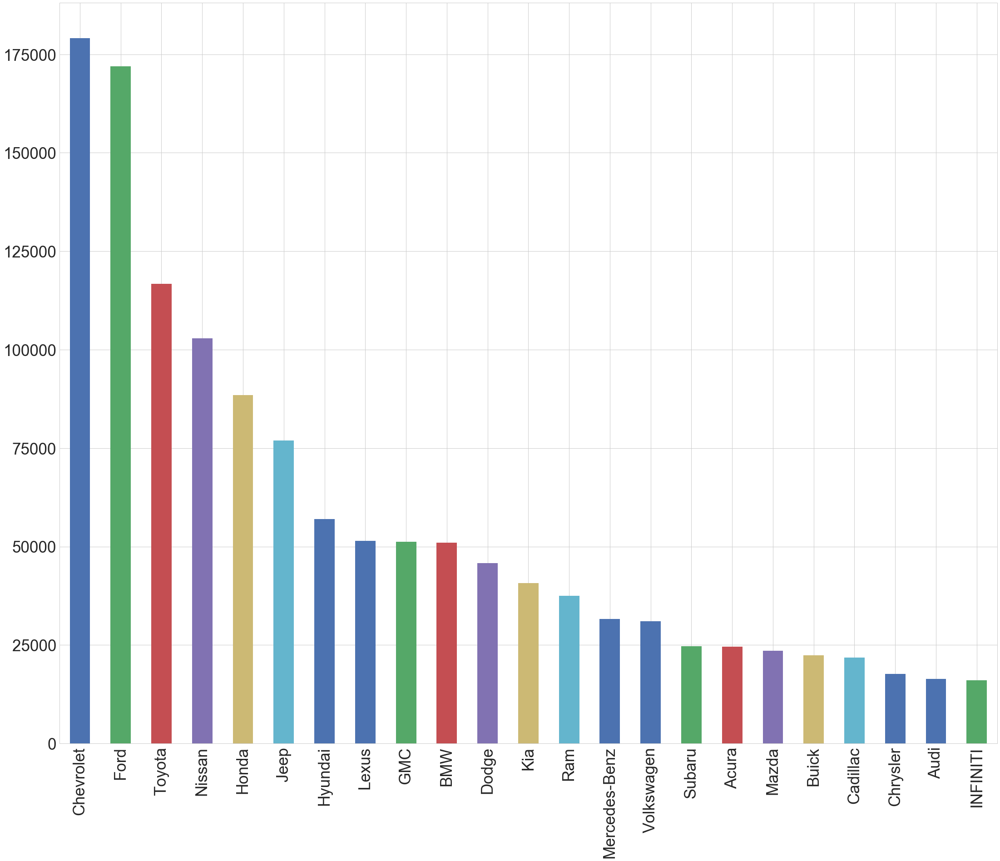
EXPLORATORY DATA ANALYSIS
Chevrolet and Ford are the most common used cars available in US

Slide 10
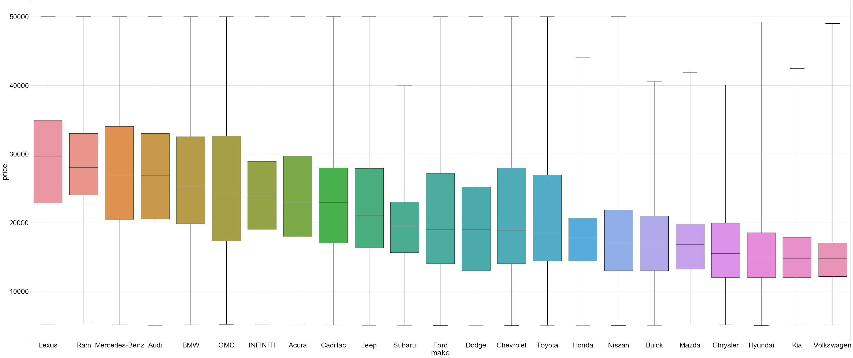
EXPLORATORY DATA ANALYSIS
Average prices can vary by as much as $15k between makes. Less expensive makes tend to have a smaller price variance.

Slide 11
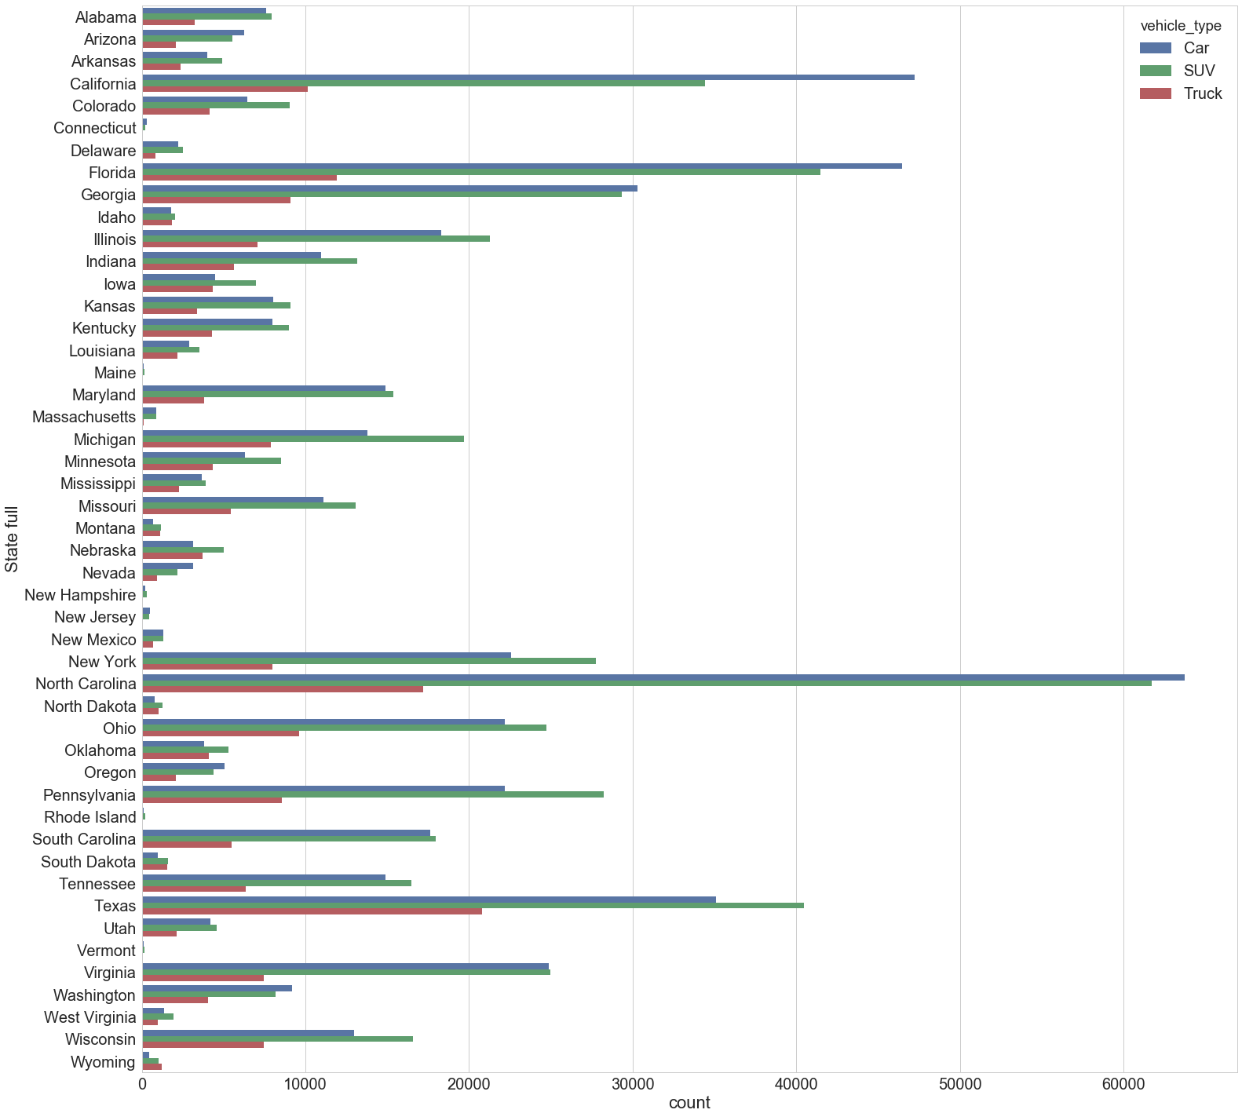
EXPLORATORY DATA ANALYSIS
There is a stark difference in the amount of listings between states, with NC possessing the most

Slide 12
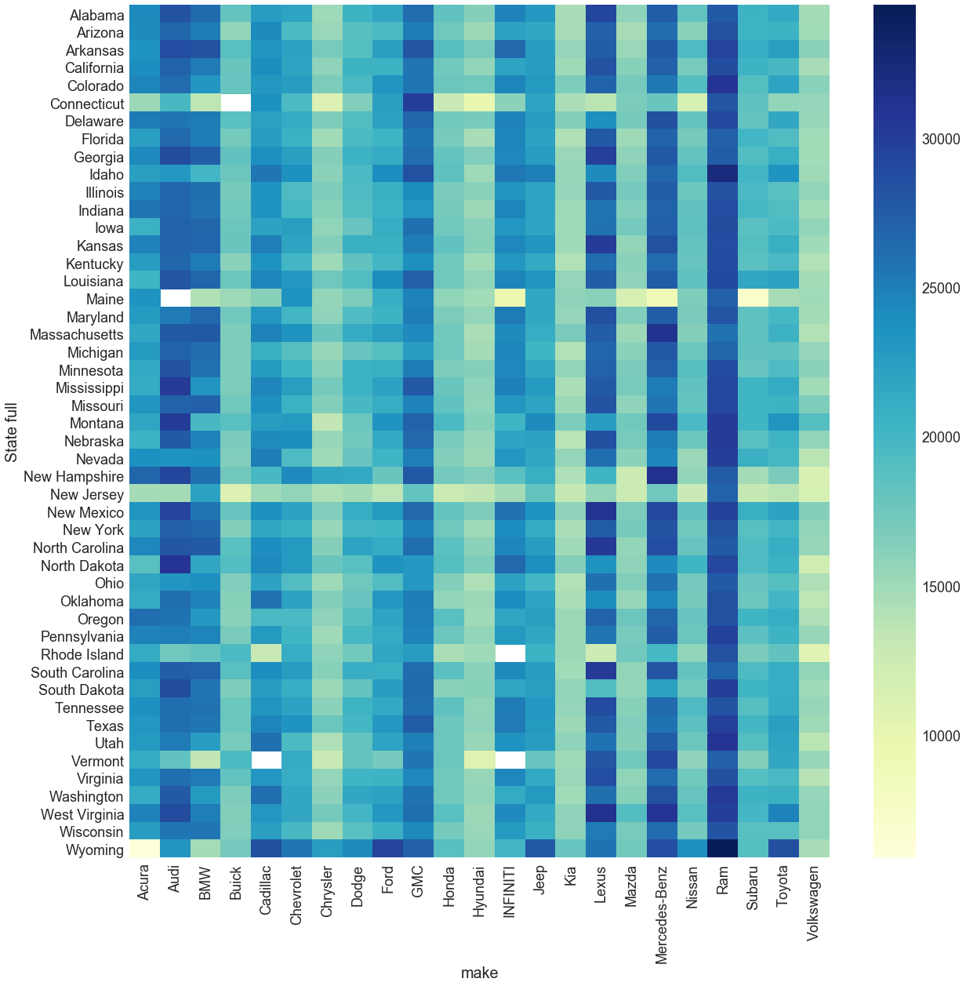
EXPLORATORY DATA ANALYSIS
The price trends between makes and states interact in interesting ways, and also reveal a few gaps in our dataset.

Slide 13
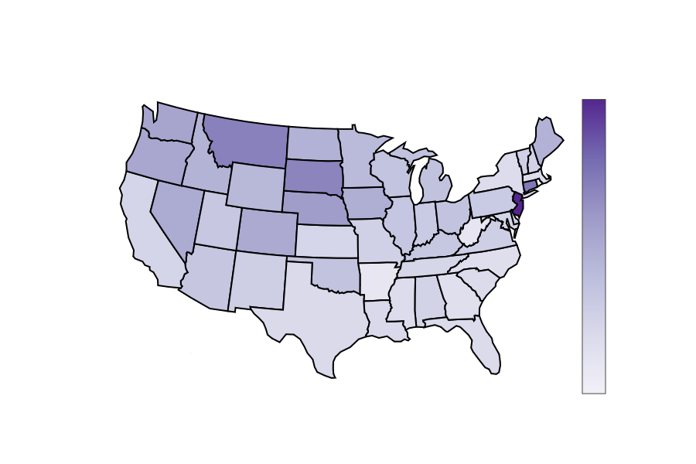
EXPLORATORY DATA ANALYSIS
Average age is mostly uniform, with it leaning slightly older in the MidWest and New Jersey as an outlier.
Mean Age of Used Vehicles
Years
6.5
6
5.5
5
4.5

Slide 14
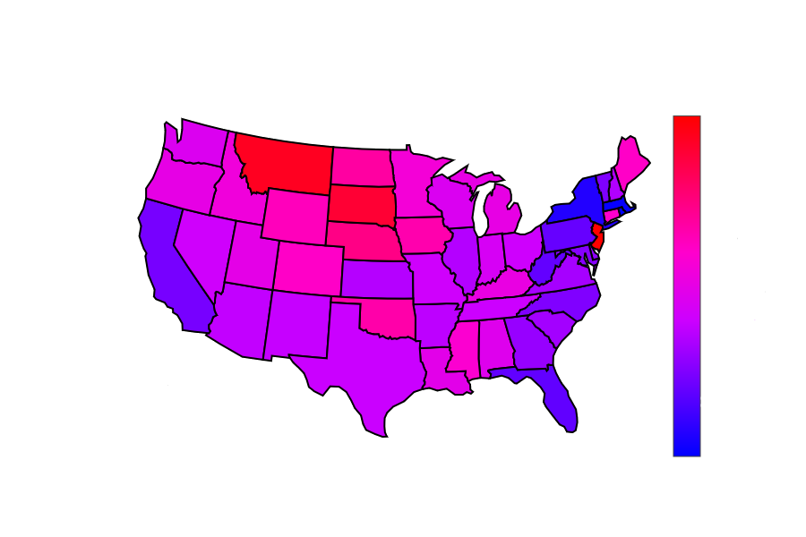
EXPLORATORY DATA ANALYSIS
Average mileage varies more, but follows a very similar pattern to the age, with MidWest being the oldest.
Mean Mileage of Used Vehicles
Miles
75k
70k
65k
60k
55k
50k
45k

Slide 15
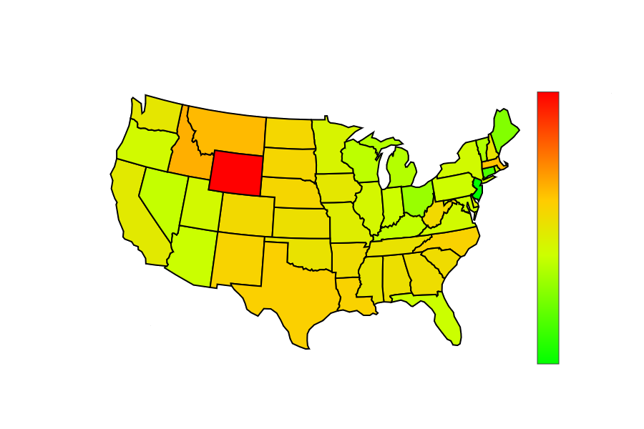
EXPLORATORY DATA ANALYSIS
Average prices are higher in the MidWest. WY stands out for having more trucks available than cars or SUVs.
Mean Price of Used Vehicles
USD
26k
24k
22k
20k
18k
16k

Slide 16
MODEL SELECTION METHODOLOGY Chronological timeline of best fit model selection
PHASE I
1.3 Million Instances with 25 features (Pearson)
Executed eight Models from four Families
Generalized Linear Models – Linear Regression, LASSO, Ridge & ElasticNet
Nearest Neighbors – K-Nearest Regressor
Ensemble Methods – Random Forest Regressor, Gradient Tree Boosting
Decision Tree – Decision Tree Regressor
Best 3 Models Selected & cross validated
Best score for Random Forest Regressor (Very High R2)
PHASE II
Consolidated Dataset to 12 best features (LASSO & Ridge)
Best 3 Models from Phase I executed & cross validated
Compared results from Phase I [25 Features] vs Phase II [12 Features]
Best score for Random Forest Regressor with 12 features

Slide 17
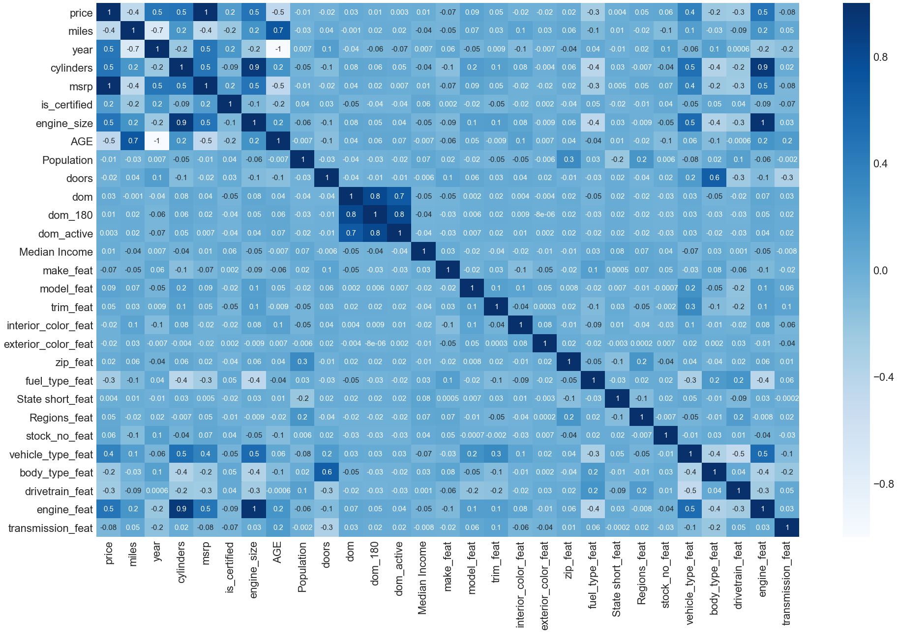
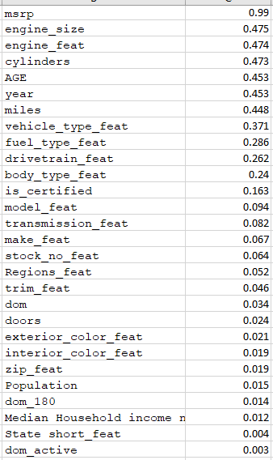
FEATURE SELECTION PHASE 1 (Pearson Correlation)

Slide 18
MODEL SELECTION PHASE 1
 | Linear Regression (LR) | Random Forest Regressor (RFR) | Gradient Boosting Regressor (GBR) | Decision Tree Regressor | LASSO | Ridge | Elastic Net | KNearest Regressor
R2 | 0.5157442205237524 | 0.970752296588402 | 0.8125462074933149 | 0.9506973144664322 | 0.5156564347075384 | 0.5157440961561774 | 0.4119656317519921 | (0.4223022137281667)
MSE | 26,949,053.60841197 | 2,339,588.661835726 | 11,908,696.52886898 | 4,068,416.2551812823 | 26,949,074.91805416 | 26,949,053.67391817 | 27,890,982.86690348 | 58,628,723.17750626
CV (R2) | 0.66447 +/- 0.00204 | 0.97128 +/- 0.00049 | 0.85478 +/- 0.00128 | n/a | n/a | n/a | n/a | n/a

Slide 19
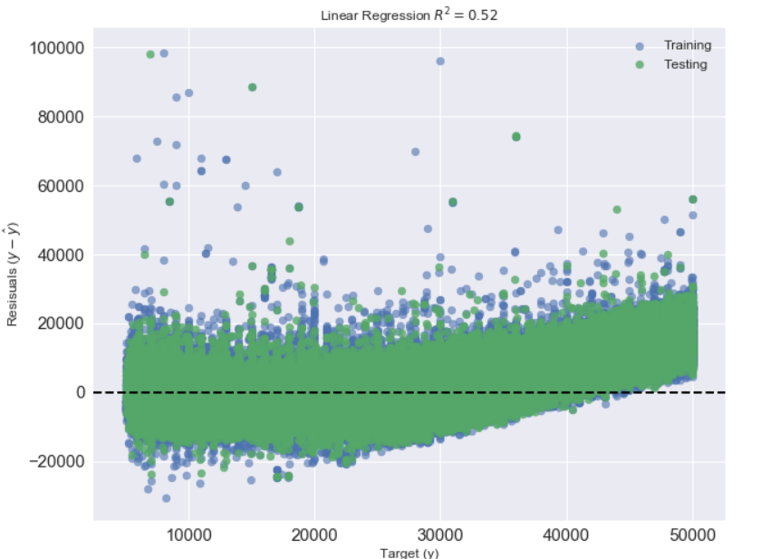
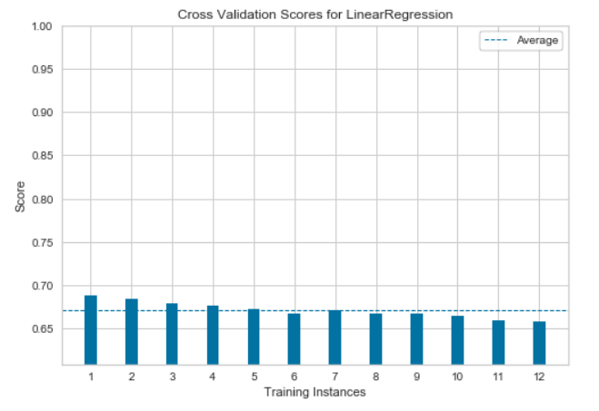
LINEAR REGRESSION (LR)
25 Features and 1.3M instances
R2 Score: 0.52
CV (R2) Score: 0.66 - 0.68
MSE: 2,6949,053.60841656

Slide 20
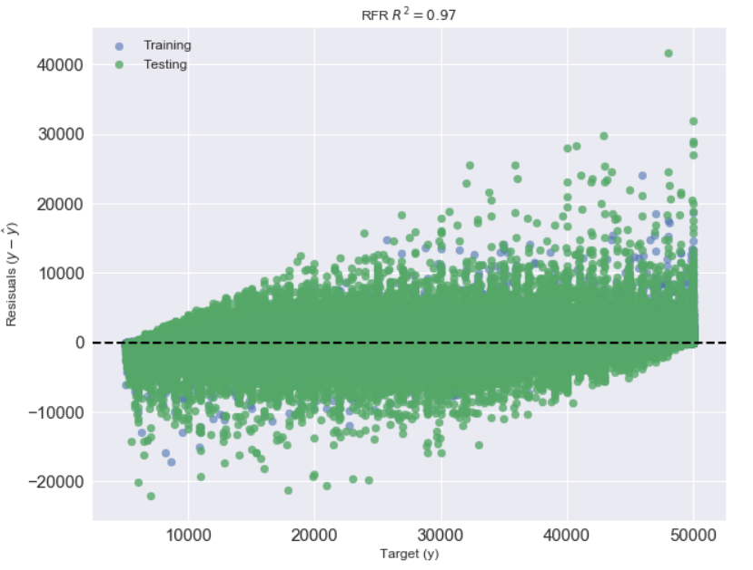
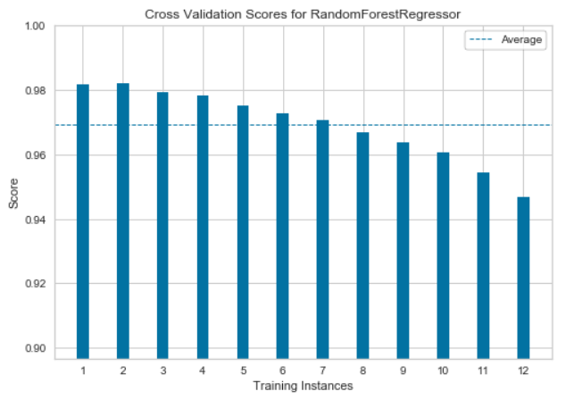
RANDOM FOREST REGRESSION (RFR)
25 Features and 1.3M instances
R2 Score: 0.97
CV (R2) Score: 0.95 - 0.98
MSE: 2,317,097.5246817297

Slide 21
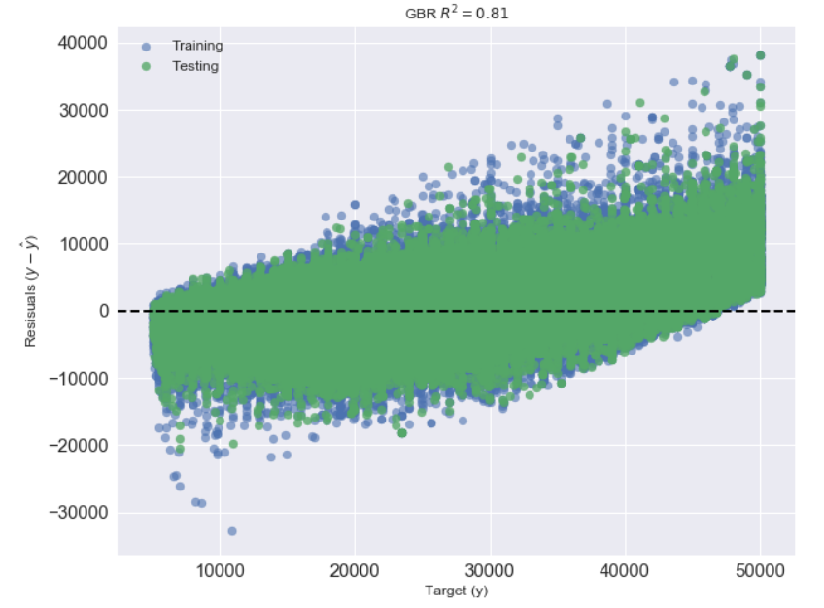
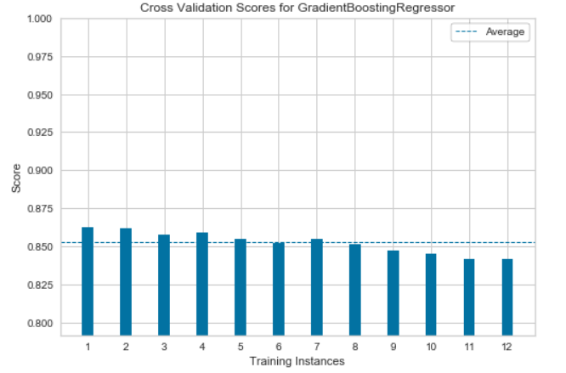
GRADIENT BOOSTING REGRESSOR (GBR)
25 Features and 1.3M instances
R2 Score: 0.81
CV (R2) Score: 0.84 - 0.86
MSE: 11,908,696.528868822

Slide 22
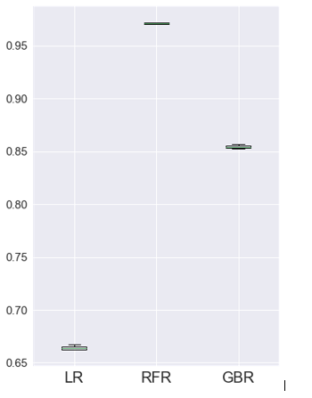
Random Forest Regressor (RFR) has highest R2 score and less MSE compared to Linear Regression (LR).
Residuals of RFR are centered around the mean +/- 10K.
As a universal model across multiple car types, RFR performs way better. But when running RFR for an individual car type the results are comparable to LR.
We performed minimal hyperparameter tuning because it could result in overfitting. Random Forest Regressor (RFR) is the best fit model
MODEL COMPARISON PHASE 1

Slide 23
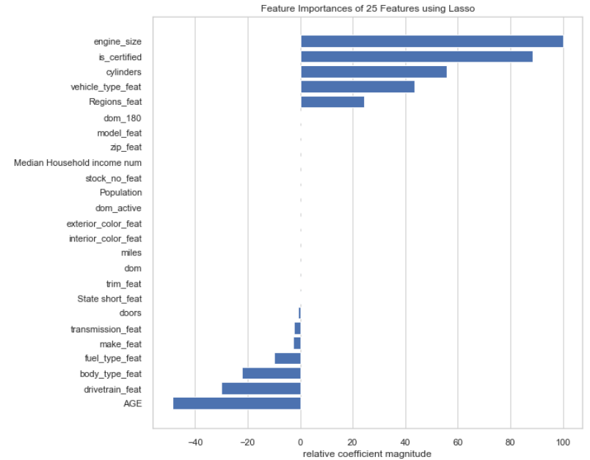
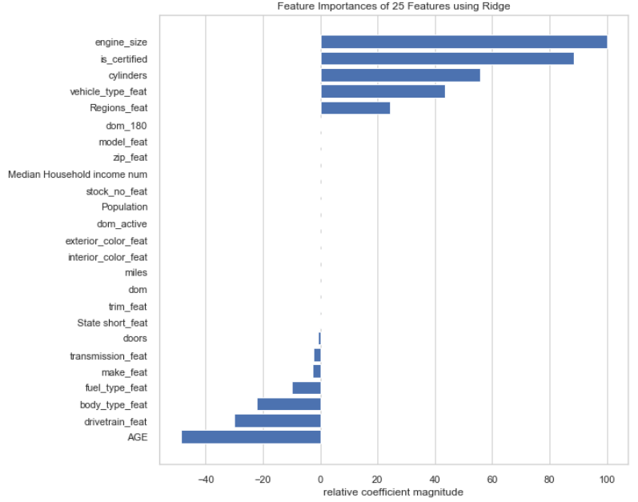
MODELLING PHASE 2 – Feature Selection
Feature Importance of LASSO and Ridge.

Slide 24
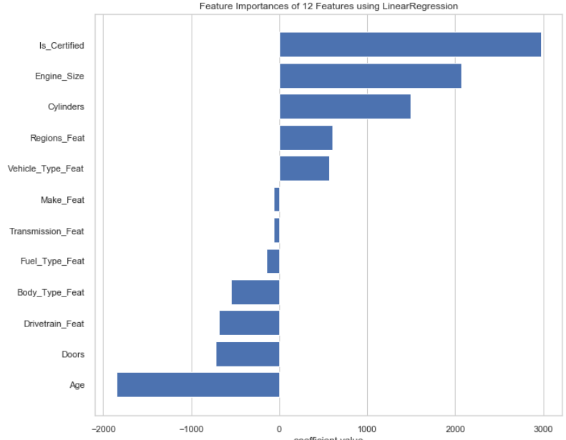
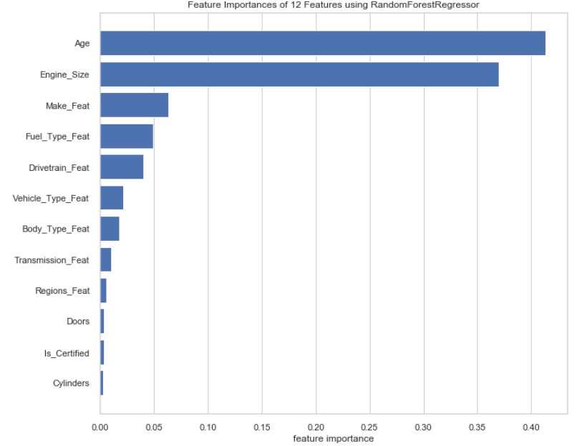
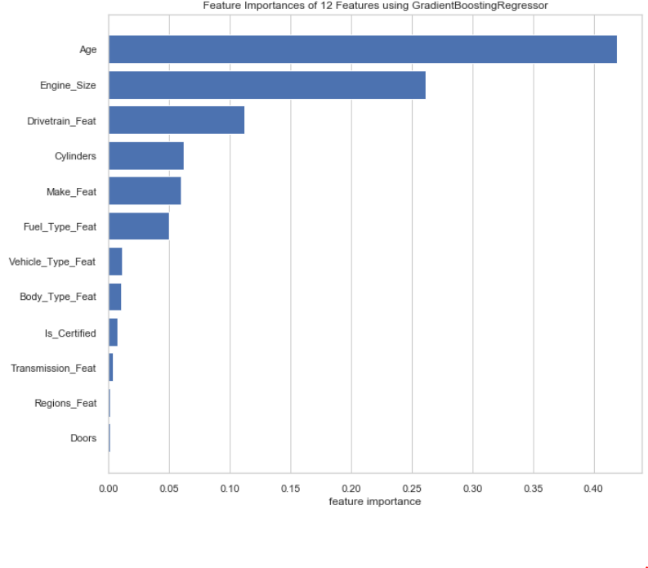
MODELLING PHASE 2 – Feature Selection
12 (out of 25) Features are Selected
Feature Importance on selected three models from Phase 1 – LR, RFR and GBR
Observations:
Reduces model complexity.
Provides more cost effective features.
Reduces the model running time.
AND …

Slide 25
MODEL COMPARISON PHASE 2
Reduces risk of model overfitting
 | Linear Regression (LR) |  | Random Forest Regressor (RFR) |  | Gradient Boosting Regressor (GBR)
 | Phase 1 (25 Features) | Phase 2 (12 Features) | Phase 1 (25 Features) | Phase 2 (12 Features) | Phase 1 (25 Features) | Phase 2 (12 Features)
R2 | 0.5157442205237524 | 0.5154229916233453 ↓↓ | 0.9710460396052453 | 0.8863299083285592 ↓↓ | 0.8125462074933152 | 0.8125462074933145 ↓↓
MSE | 26,949,053.60841197 | 26,961,391.502688333 ↑↑ | 2,317,097.5246817297 | 2,338,193.0603683274 ↑↑ | 11,908,696.528868822 | 11,908,696.528868886 ↑↑
CV (R2) | 0.66447 +/- 0.00204 | 0.61432 +/- 0.00222 ↓↓ | 0.97128 +/- 0.00049 | 0.89741 +/- 0.00082 ↓↓ | 0.85478 +/- 0.00128 | 0.82082 +/- 0.00189 ↓↓
FINAL CONCLUSION: RANDOM FOREST WITH 12 FEATURES IS BEST FIT MODEL

Slide 26
DATA PRODUCT (Web App) - Initial
Customer Focused – Car Prediction App
Django or Flask
User Input
Make
Model
Year
Zip Code
Provide Prediction(s) and Insight(s)
Price Prediction Per Selected Car
Best Year for Deals
Best Make and/or Models for Deals
Region Specific Deals
Alternate Makes and Models The User Might Like

Slide 27
DATA PRODUCT (Jupyter Widgets) - Actual
Customer Focused – Car Buying Pre-Production Code
Jupyter Notebook with Prediction Code
User Input(s)
Make
Model
Year
Body Type
Zip Code
Goal: Display our Top two predictors Using Dummy Variables
Take a Random Vehicle
Use Gradient Boosting Regressor and Random Forest Regressor to Predict the Price

Slide 28
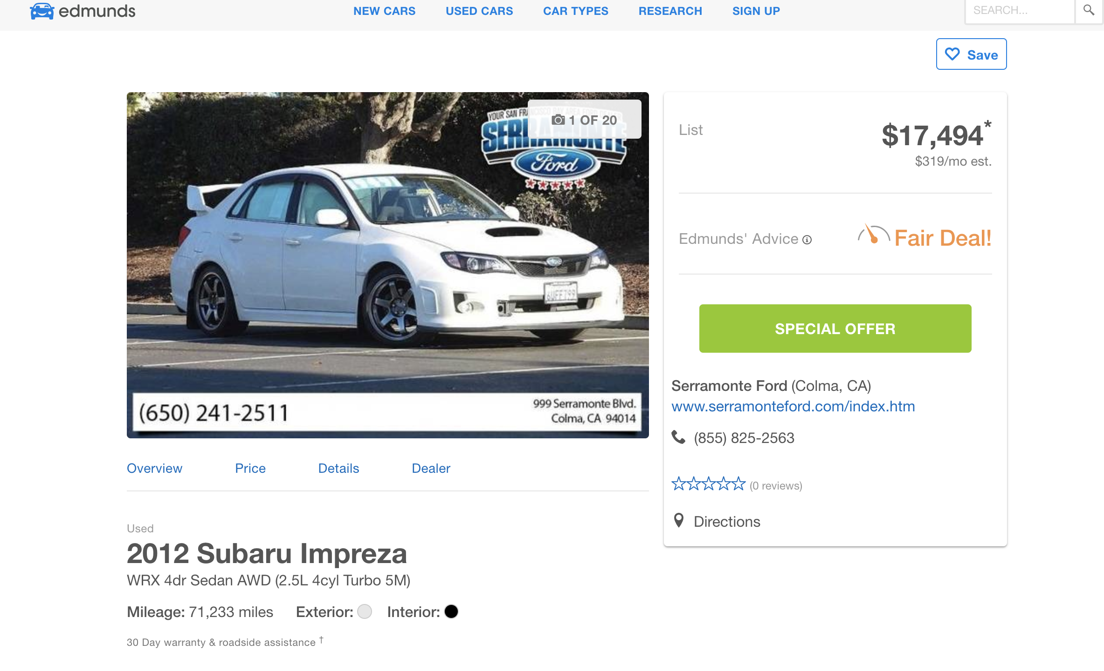
Vehicle we used in testing

Slide 29
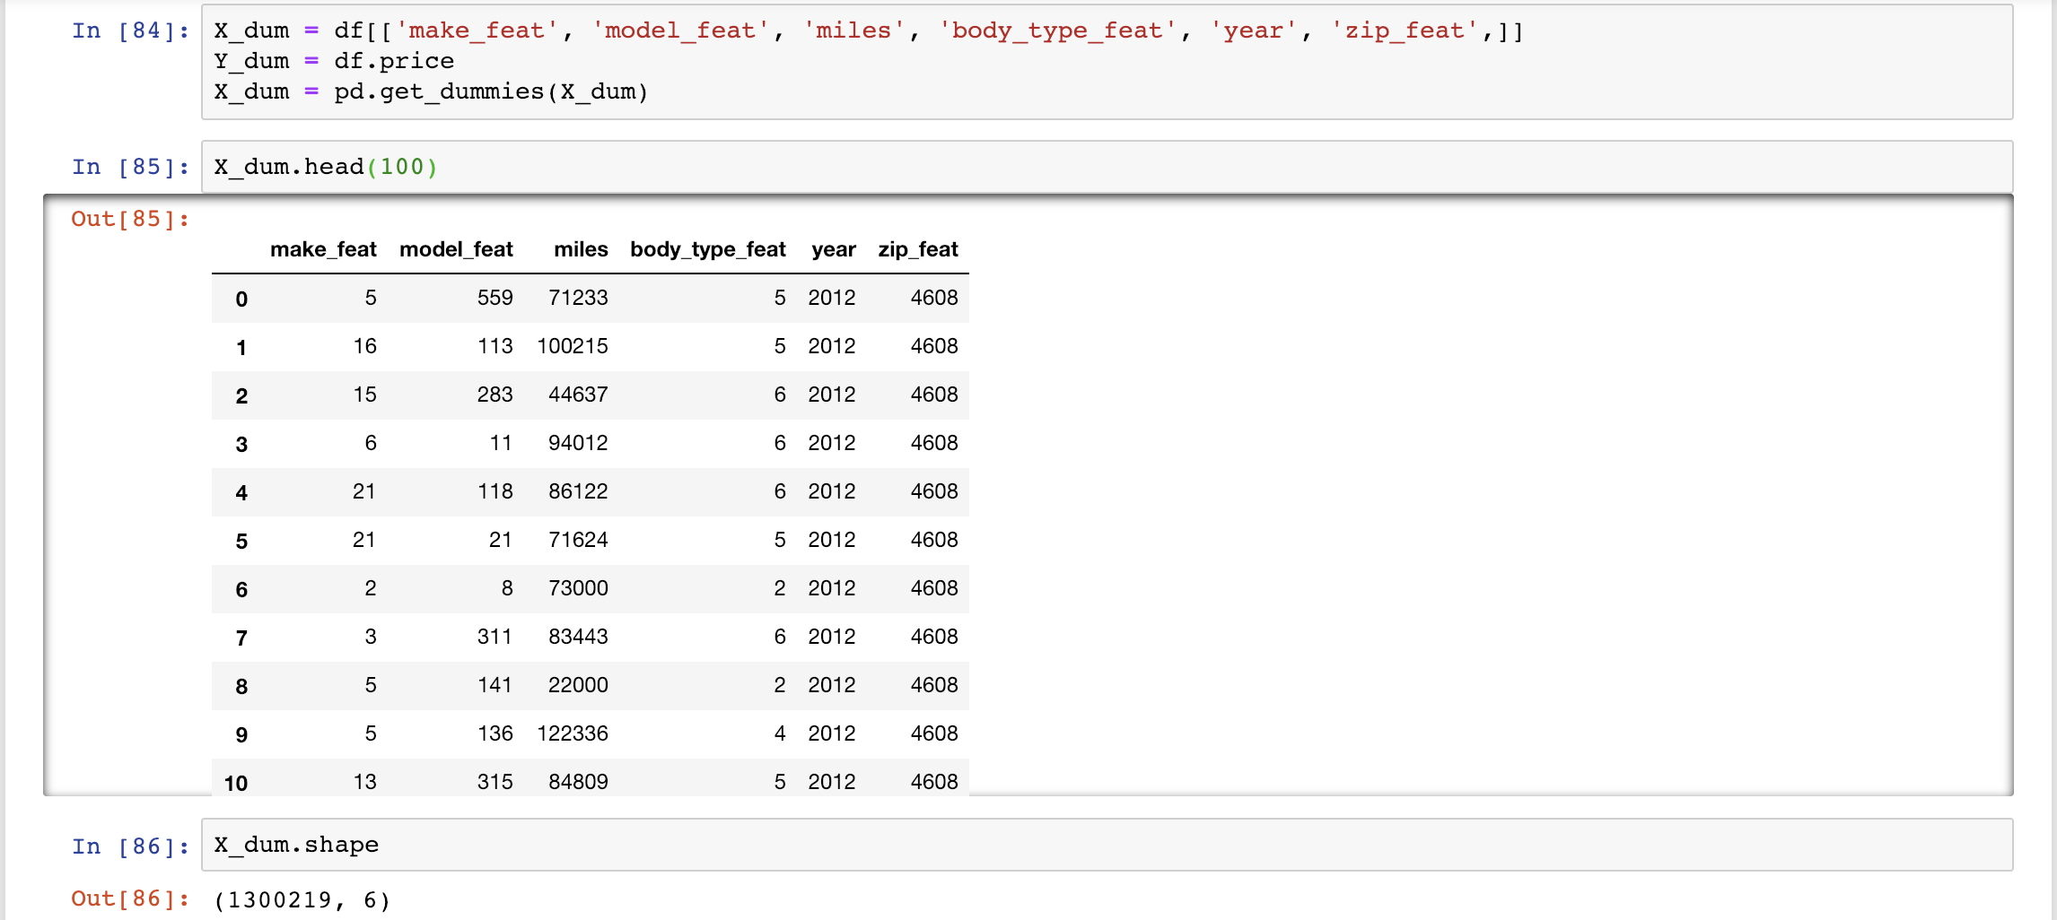
Dummy Variables

Slide 30
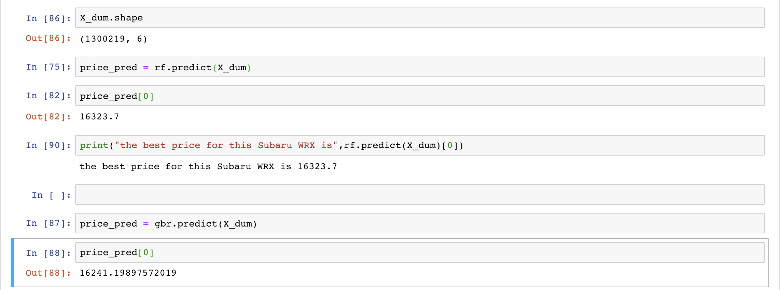
Random Forest Regressor and Gradient Boosting Regressor

Slide 31
CONCLUSIONS
Data analysis indicates that a listing’s location has a smaller impact on price compared to the vehicle’s other features, such as age and mileage, however regional trends in prices do still exist.
The biggest regional impact on price is population and urbanization, causing the rural MidWest states to have the highest price, and the NorthEastern states the lowest price.
Random Forest Regressor is our best performing model overall, largely thanks to the number of non-linear features causing a decrease in Linear Regression performance.
Reducing feature dimensionality using LASSO and Ridge regularization models. Reduces the risk of model overfitting.

Slide 32
THE NEXT STEPS
Write individual models for each vehicle type and then use Bagging Regressor to aggregate their individual predictions (either by voting or by averaging) to form a final prediction and compare that to the universal RFR.
Expand the data set and use it to explore seasonal price fluctuations.
Establish and streamline a pipeline to ingest new data and integrate it into the model.

Slide 33
QUESTIONS?

